Slide 1
Prostruc Algorithm/workflow
Input Sequence
Genetic Database search
MSA
Structural Database Search
Templates
Structure Module
3D-Structure

Slide 2
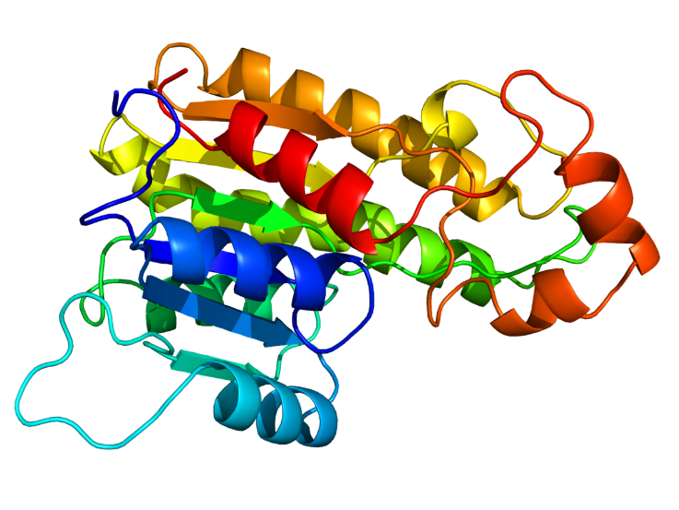
Genetic Database search
Basic statistics and protein analysis
Input Sequence
MSA
Templates
Structural Database Search
Structure Module
Model Optimization
Model Building
Model Validation
3D Structure

Slide 3
Prostruc Algorithm
─ input.fasta
├── align2d.py
├── build_profile.py
├── download_pdbchain.py
├── model_single.py
├── pdball.bin
├── rename.sh
└── start-modeling.sh
High-Level Steps
Sequence Alignment: Align the target sequence with a database of known protein structures.
Template Selection: Choose a suitable template based on the alignment.
Model Building: Construct the 3D model of the target protein using the template.
Model Optimization: Refine and optimize the model.
Model Validation: Validate the accuracy of the model.

Slide 4
Homology Modelling
Homology modeling is a powerful computational technique used in structural biology to predict the three-dimensional (3D) structure of a target protein based on its similarity to known structures (templates). In this project, we are developing a homology modeling tool that aims to streamline the process of protein structure prediction by automating sequence alignment, template selection, and preliminary structure validation. This tool use Biopython for sequence alignment and template retrieval via BLAST searches, making it accessible and easy to use for researchers without requiring extensive computational resources.

Slide 5
The key perks of this homology modeling tool include:
User-Friendly Interface: Designed to be easy to use, with clear input and output steps, allowing researchers to focus on their scientific questions rather than the technical details of the modeling process.
Automated Template Selection: Integrates BLAST search functionality to automatically identify and select the most suitable template structures from the Protein Data Bank (PDB), ensuring high-quality starting points for modeling.
Flexibility and Customization: While the tool provides a streamlined default workflow, it is also designed to be flexible, allowing users to customize alignment parameters and integrate additional structure prediction and validation tools as needed.
Scalability: Suitable for both small-scale studies and larger projects, the tool can handle multiple sequences and templates efficiently, making it a valuable asset for high-throughput structural biology research.
Open Source and Extensible: Built using open-source libraries, this tool can be easily extended and improved by the research community, fostering collaboration and continuous enhancement of its capabilities.

